Slide 1
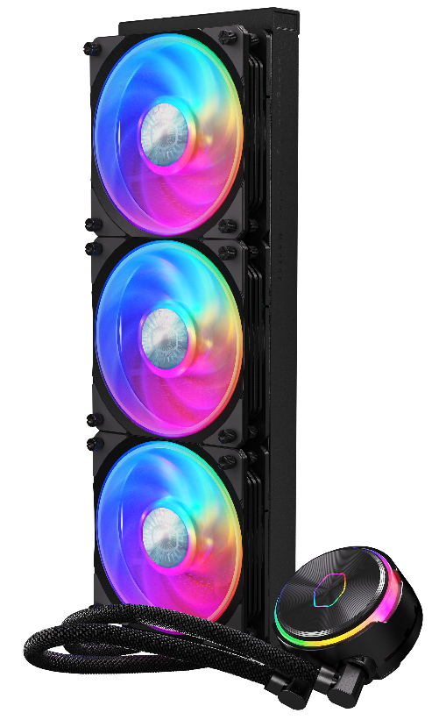
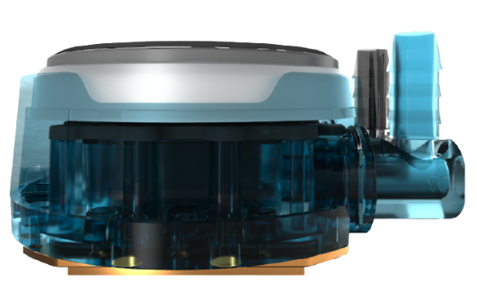
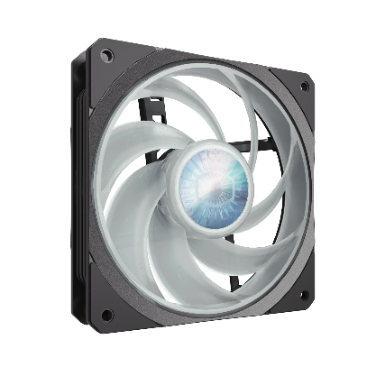
Cooler Master’s MasterLiquid PL360 Flux is the new embodiment of enhanced performance cooling. The dual chamber pump has further honed flow and pressure to target hot spots for rapid and precise heat dissipation. Surface area of the copper base and microchannels have been calculated for a superior heat transfer ratio. Equipped with new fan blades with an interconnecting loop delivering high speed performance, the fan fine is tuned to produce an optimized sound output. It also integrates new Addressable Gen 2 RGB for support with major motherboard manufactures, customizable with both the included Addressable Gen 2 RGB controller and Cooler Master’s MasterPlus+ software.
MASTERLIQUID
PL360 FLUX
Dual Chamber Pump
Enhanced Air Balance Fan Blades
Slim & Sleek Radiator
New Compact Performance Dual Chamber pump delivers the perfect balance of water flow and pressure for impressive cooling.
120 mm square frame ARGB fan designed with inter-connecting air balance fan blades uniquely modified for the PL-Flux Series.
Low profile radiator with superior fin density coupled with performance fans dissipates heat rapidly.
Ultimate Heat Exchange
High speed motor utilizing a ceramic bearing impeller forces balanced water flow to and from the radiator for ultimate efficiency of heat exchange.
Superior Performance Ratio
Precision engineered ultra-thin spaded fins maximizes microchannels accurately targets heat spots. Enlarged copper base surface area optimized with ideal base thickness accelerates heat transfer.

Slide 2
PL-Flux specific fans
Inter-conneting air balance fan blades increased sturdiness and stability operating steadily at high speed. Angled inner rim of fan frame increasing intake of air, at the same time gap between from and blades creating greater air pressure.
Performance Dual Chamber – Optimized flow and pressure targeting hot spots for precision heat dissipation
Superior Performance Ratio - Combined copper base and microchannel to surface area refined for ultimate heat transfer maximization
Radiator Fan Enhancement - Enhanced fan blades with interconnecting loop delivers high speed performance
Fan Noise Calibration - Fine tuned fan engineering produces optimized noise output
Dual Loop ARGB Pump Lighting - Addressable Gen 2 RGB ready for independent implemented customization
Product Name | MasterLiquid PL360 FLUX
Product Number | MLY-D36M-A23PZ-R1
Exterior Color | Black
RAM Clearance | N/A
Warranty | 5 years
CPU Socket | Intel | Intel® LGA 1700 /1200 / 2066 / 2011-v3 / 2011 / 1200 / 1151 / 1150 / 1155 / 1156 socket
 | AMD | AMD® AM4 / AM3+ / AM3 / AM2+/ AM2 / FM2+ / FM2 / FM1/TR4
Radiator | Material | Aluminum
 | Dimensions (L x W x H) | 394 x 119.6 x 27.2mm(15.5 x 4.7 x 1.07inch)
Pump | Dimensions (L x W x H) | 89 x 75 x 40 mm (3.5 x 2.95 x 1.57 inch)
 | MTTF | >210,000 hours
 | Noise Level (Max) | 15dB(A)
 | Connector | 4-Pin
 | Rated Voltage | 12 VDC
 | Power Consumption | 6 W
Fan | Dimensions (L x W x H) | 120 x 120 x 25 mm(4.7 x 4.7 x 1 inch)
 | Quantity | 3 Pcs
 | LED Type | Addressable Gen 2 RGB
 | Speed (RPM) | 0~2300 ±10%
 | Airflow (Max) | 122.96 m³/h (72.37 CFM)
 | Noise Level (Max) | 32dB(A)
 | Pressure (Max) | 2.96 (mmH2O)
 | Bearing | ORBS
 | Life Expectancy | >160,000 hours
 | Power Connector | 4-Pin PWM
 | Rated Voltage | 12 VDC
 | Rated Current | 0.15A
 | Safety Current | 0.3A
EAN code | 4719512123645
UPC code | 884102095962
Net weight | 1.98kg
Gross weight | 3.01kg
Package dimension (L x W X H) | 43.7 X 23.2 X 14.4 cm
Carton dimension (L x W x H) | 57 x 45.5 x 26.5 cm
Units/CTN | 4
Cont. | W/ Pallet | Carton/ Pallet | W/O Pallet
20’ | 1120 | 28 | N/A
40’ | 2352 | 28 | N/A
40 HQ | 2688 | 32 | N/A

